Slide 1
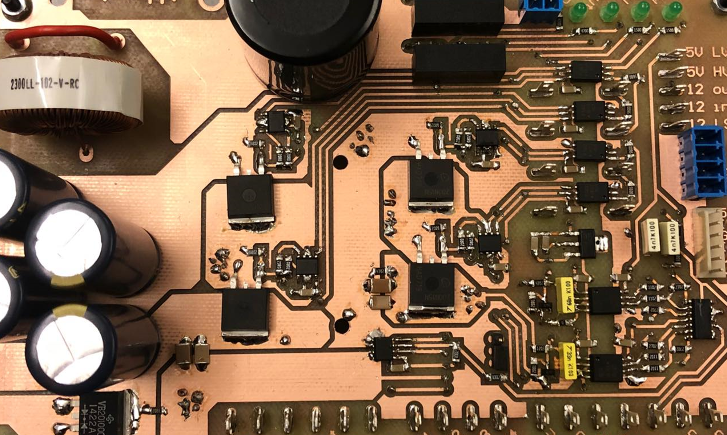
Test results
Notes:
Motivation
Existing problems
What is a MIC
Why a MIC
Problem statement

Slide 2
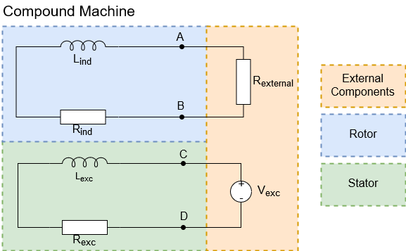
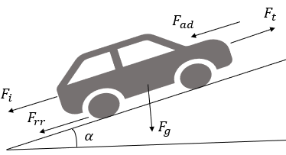
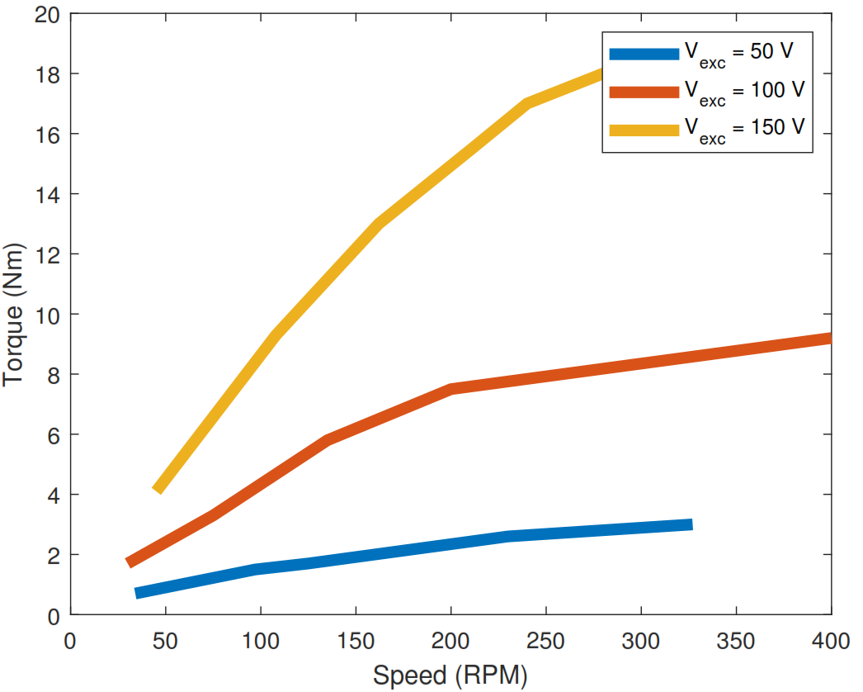
Load difference
Load motor
Go-kart load
Notes:
Simulation results are also different.
Mechanical model is completely different, which affects speed load but not torque reference due to similar RL load.
Mention PI parameters are different than in simulation.

Slide 3
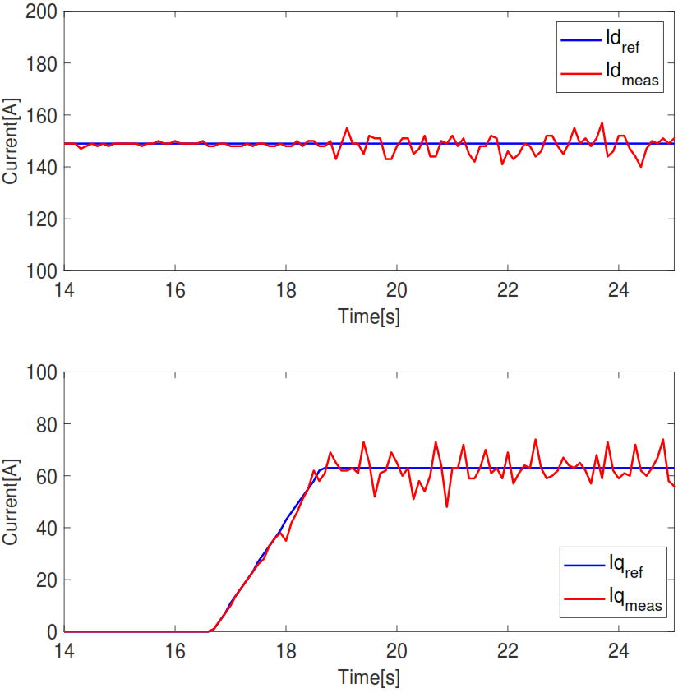
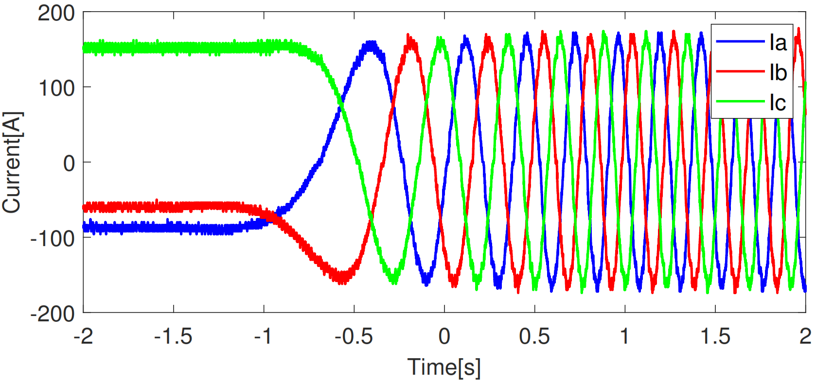
Torque control - Startup

Slide 4
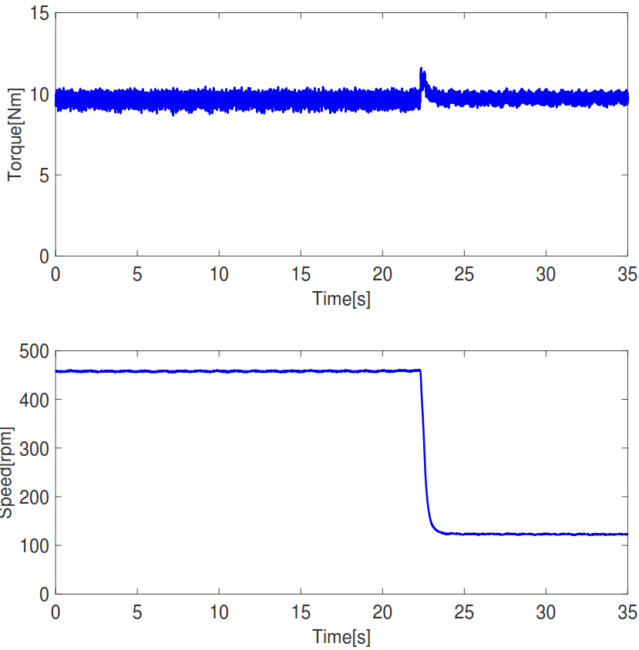
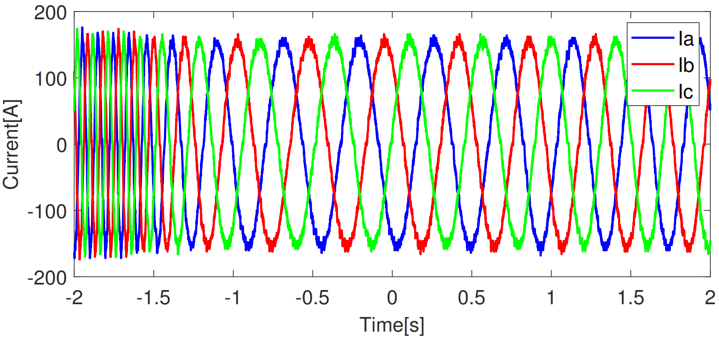
Torque control – Load change
Notes:
Explain the change on speed in the right

Slide 5
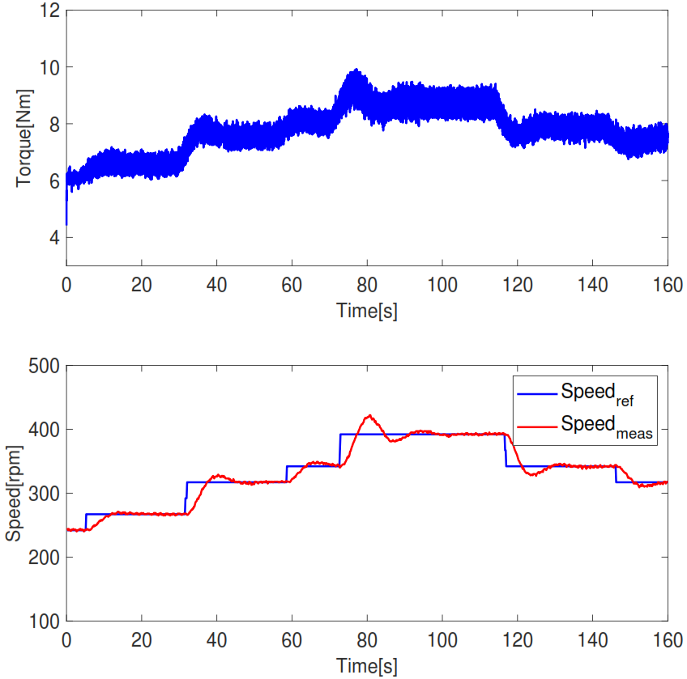
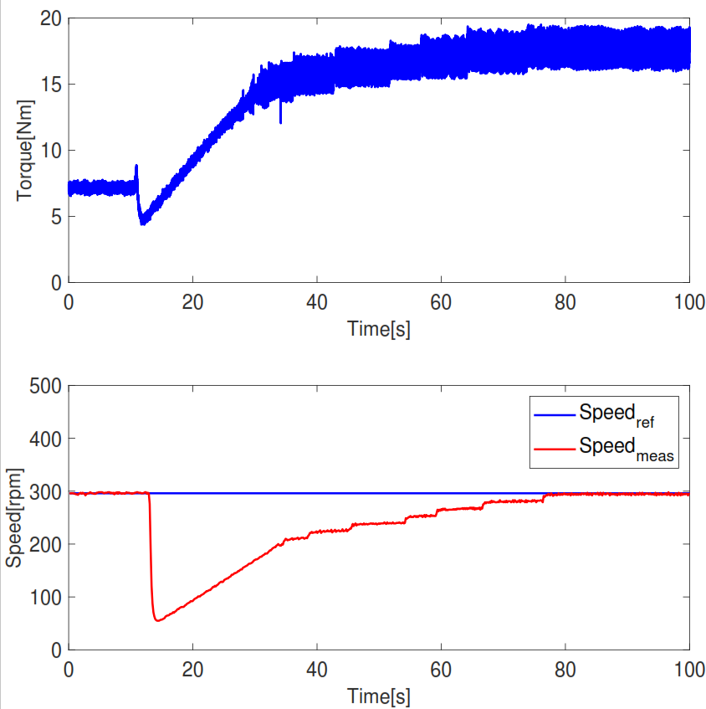
Speed control
Speed variation
Load variation
Notes:
Do not say real life, say tests, experimental…
Speed control is not quick, it’s actually slow.
Also talk about inertia here.
Not say actually and oscillations, more overshoot.
Steps of 25 or 50.

Slide 6
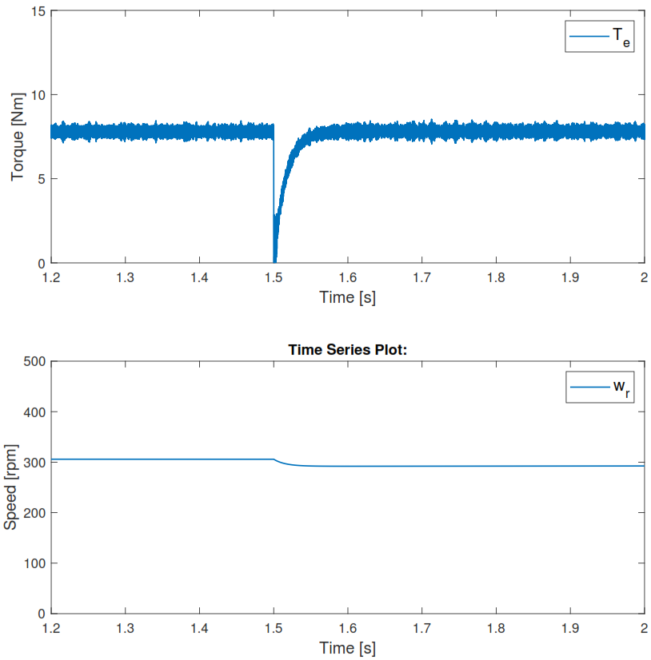
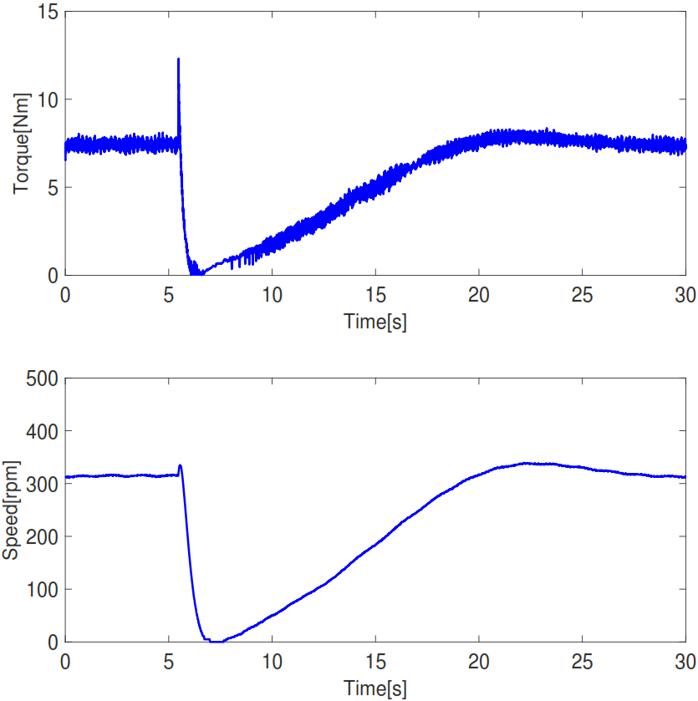
Torque to speed transition
Simulation
Tests
Notes:
PI error is zero at the beginning and so torque ref goes down to zero, inertia helps stabilizing.
GENERAL: Overview slide in the beginning.

Slide 7
Future work
Slide
of 59
Alternative approach in field oriented control.
Implementation of regenerative braking.
Performance at higher switching frequency.
Integrating the power train in the go-kart platform.
Thassilo
Notes:
Add arrows.

Slide 8
Conclusions
Slide
of 59
Make summary.
Mention what went good.
Big step between simulation and implementation.
Add PM.
Thassilo
Notes:
Add technical conclusions.
Change for arrows.

Slide 9
Thank you for your attention
Questions?

